Slide 1
Digital Portfolio
STUDENT NAME: Narmatha.P
REGISTER NO AND NMID: 2422k2184 ABE57FA2BB5131289C24880EC58E0DFB
DEPARTMENT: Bsc Computer Science
COLLEGE: COLLEGE/ UNIVERSITY: Puratchi Thalivi Amma Government Arts and Science College/Bharathiyar University

Slide 2
PROJECT TITLE
ASSIGNMENT PROBLEM

Slide 3


AGENDTA
Problem Statement
Project Overview
End Users
Tools and Technologies
Portfolio design and Layout
Features and Functionality
Results and Screenshots
Conclusion
Github Link
3/21/2024 Annual Review

Slide 4
PROBLEM STATEMENT
Students often struggle to present their academic achievements, skills, and projects in a structured and professional manner. Traditional resumes fail to capture creativity, practical skills, and hands-on experiences, making it difficult for students to stand out in academic or career opportunities. There is a need for a digital portfolio solution that allows students to effectively showcase their competencies, projects, and growth.

Slide 5

PROJECT OVERVIEW
The problem is usually represented as a cost matrix, where each cell indicates the cost of assigning a specific agent to a task. The most common solution technique is the Hungarian Algorithm (a.k.a. Kuhn-Munkres algorithm), which solves the problem in polynomial time and guarantees an optimal assignment.
By developing this portfolio system,student will have a
personalized digital identity that goes beyond a traditional
CV, enchancing their chances of securing opportunities in
competitive environments. It will also provide academic
institutions and recruiters with a reliable and holistic view
of a students’s potential.

Slide 6

WHO ARE THE END USERS?
Primary End User Students

Slide 7

TOOLS AND TECHNIQUES
Tools:
Trebedit
Techniques:
HTML5
CSS3
JavaScript

Slide 8
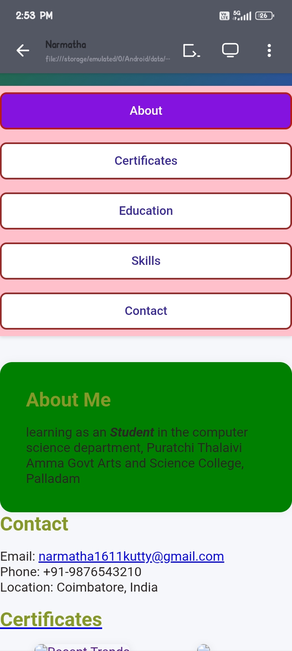
POTFOLIO DESIGN AND LAYOUT
8

Slide 9
FEATURES AND FUNCTIONALITY
Features = What’s inside (profile, skills, projects, achievements, etc.). Functionalities = What users can do (create, edit, share, export, search).

Slide 10
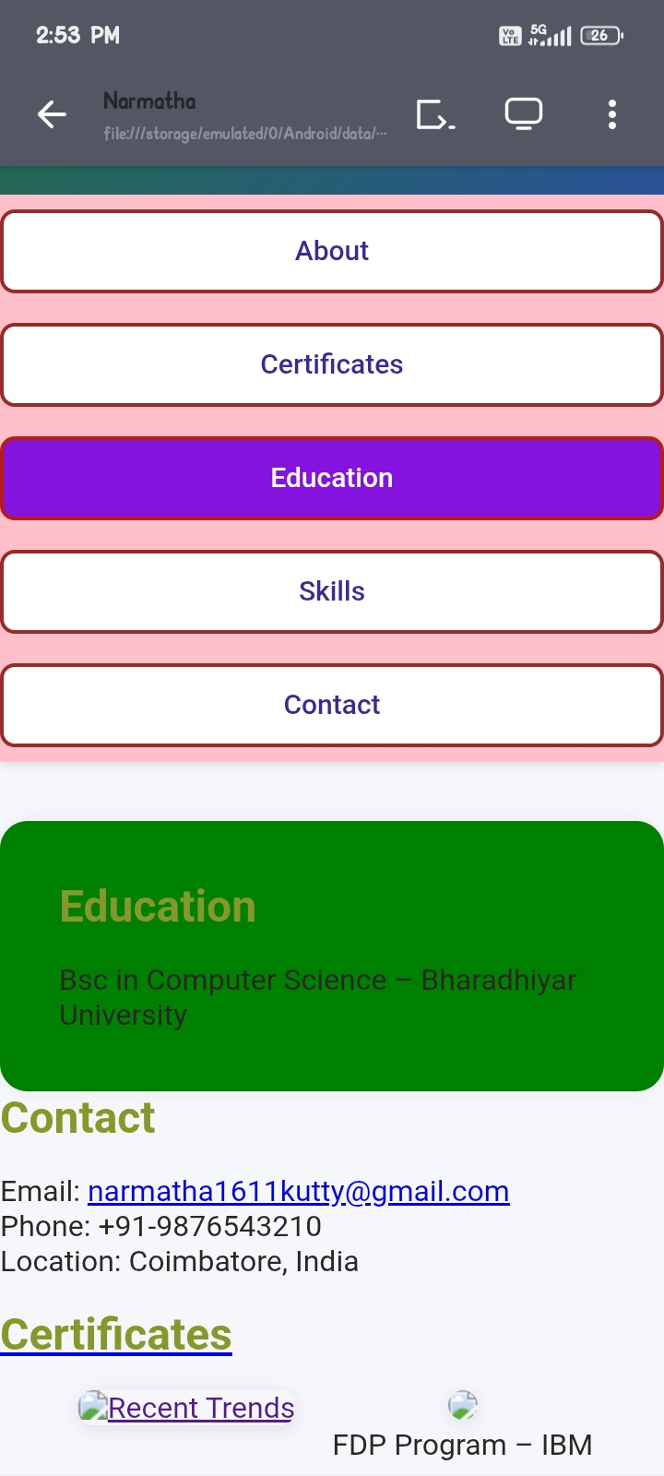
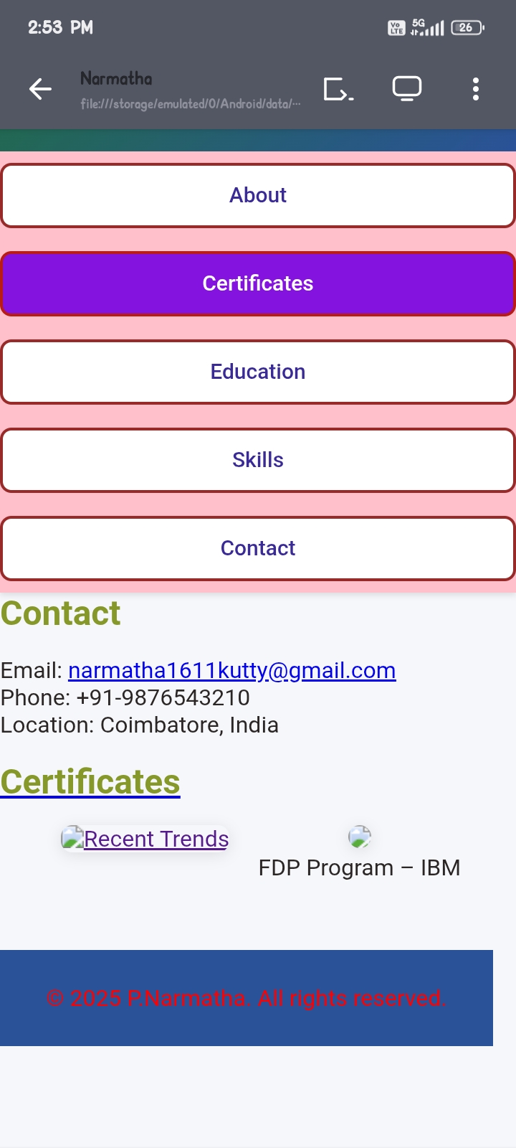

RESULTS AND SCREENSHOTS
3/21/2024 Annual Review
10

Slide 11
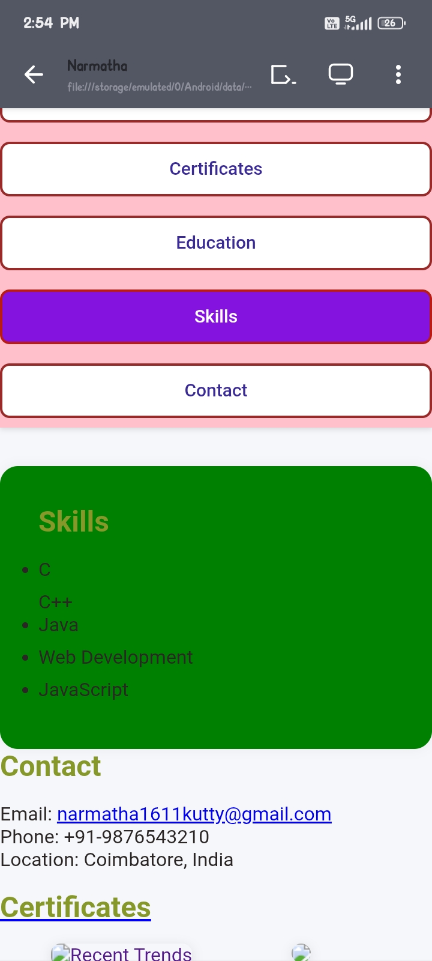
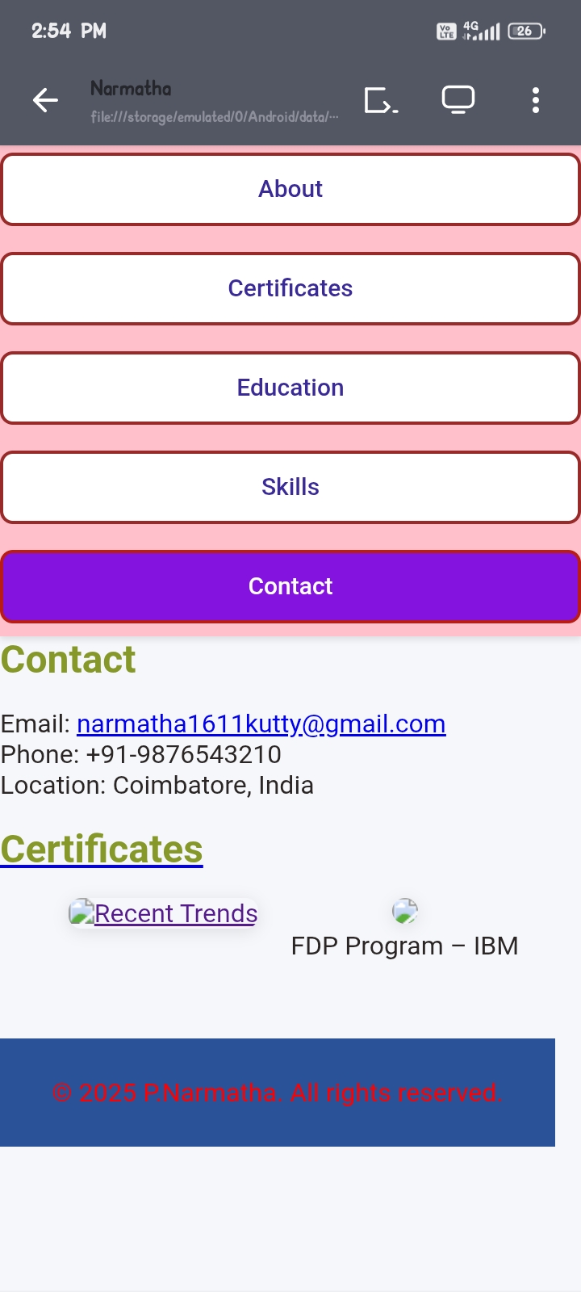
11

Slide 12
CONLUSION
The assignment problem is a fundamental optimization problem in operations research that deals with assigning a set of tasks to a set of agents in the most efficient way, minimizing cost or maximizing profit. It ensures that resources are allocated optimally without duplication or wastage. Methods such as the Hungarian Algorithm provide systematic and efficient solutions to these problems. The wide application of the assignment problem in areas like job scheduling, transportation, project management, and decision-making highlights its importance. In conclusion, solving the assignment problem not only reduces cost and time but also improves productivity and resource utilization.

Slide 13
GITHUB LINK

Slide 14
Thank You🙏

